Slide 1
Uber Risk Analysis
Jason Buitrago, Dylan Glass, Quijhanae Lee, Justin Printz

Slide 2

Uber
Modern-day taxi service
Provides cheap and efficient rides
Easy-to-use application
Available 24/7

Slide 3
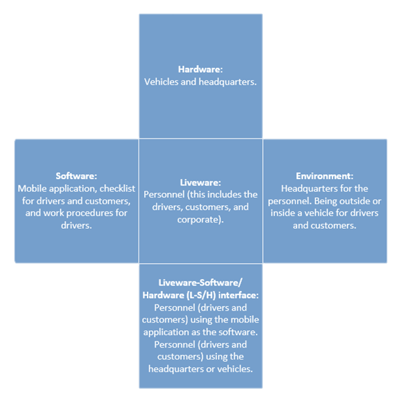
SHEL Model
Hardware
Software
Liveware
Environment
Liveware-Software/Hardware (L-S/H) interface
Notes:
Hardware:
Vehicles and headquarters.
Software:
Mobile application, checklist for drivers and customers, and work procedures for drivers.
Liveware:
Personnel (this includes the drivers, customers, and corporate).
Environment:
Headquarters for the personnel. Being outside or inside a vehicle for drivers and customers.
Liveware-Software/Hardware (L-S/H) interface:
Personnel (drivers and customers) using the mobile application as the software. Personnel (drivers and customers) using the headquarters or vehicles.

Slide 4
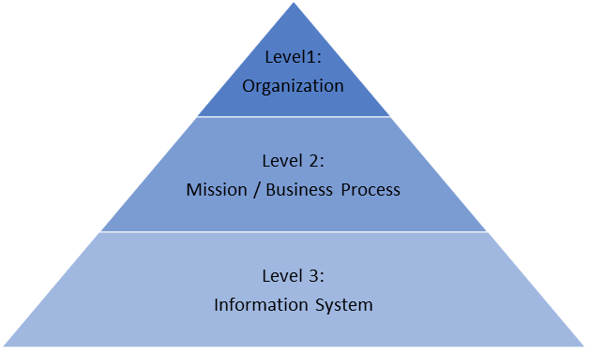
NIST Model
Level 1:
Uber
Level 2:
Purchasing a ride through application
Receiving ride from driver
Level 3:
Driver submits a request
Drop-off location

Slide 5
Benefits
Figuring out security flaws
Potential decrease in the value of assets
Affects stakeholders
Internal and external problems
Web/mobile application
Driver/customer issues

Slide 6
Constraints
Not having the exact information needed
Includes numbers for assets
Affects stakeholders
Possible legal issues
Budget issues
Internally or externally for company

Slide 7
Product Lines
UberX, Uber Pool, Uber Comfort, Uber Green, Uber Black, Uber Scooter, Uber Bikes, UberXL, Uber Transit, Uber WAV, Uber Lux, Uber Black SUV, Uber Taxi, Uber Flash, Uber Auto, and Uber Air
Three most popular UberX, Uber Pool, and Uber Comfort

Slide 8

Mission Statement
“We ignite opportunity by setting the world in motion.”

Slide 9
Essential Business Functions
Investors
Financing
Customer Service
Stocks - Value, growth, exchanges
Physical Safety - Drivers & customers
Information Technology -
Mobile application functions
Research and development
Review and ratings
Website functions

Slide 10
Stakeholder Analysis
Possible Stakeholder | Type of Stakeholder | Importance (1-4)
Dara Khosrowshahi | Definitive | 4
Riders | Dependent | 3
Drivers | Dependent | 3
Investors | Dominant | 2
Government | Dangerous | 2
Employees | Dominant | 2
Mobile operating systems providers | Discretionary | 1
Uber’s CEO Dara Khosrowshahi
CEO is the face of the company, most important stakeholder
Responsible for updating the stakeholders about what is going on inside of the company

Slide 11
Stakeholder Analysis Cont.
Riders and Drivers
Do not hold a lot of power, but their concerns are very important
They are the everyday users, if something needs to be done, they can express concerns
Investors and Employes
Company would not be able to function without them
Have power to get things done
Government
Dangerous because they have power
Mobile Operating Systems
Discretionary because they are legitimate but have no power or urgency

Slide 12
Project Scopes Statements
Functions | Assets | Input and Output
Corporate espionage | Employees, stakeholders, customers | Input: Someone spies on company Output: Company gets information stolen, as a result have a bad reputation
Software | Data, employees, end users, application | Input: Coders work on the backend Output: Better usability for the users
Stocks | Financial, stakeholders | Input: Someone invests in Uber Output: Stock goes up, Uber gets more to invest in themselves
Notes:
Project Scopes statement
The business functions that Uber focuses on are corporate espionage, software, and stocks. Corporate espionage is one of the most important functions, it makes sure that there are no breaches, leaks, or any information stolen. The software for Uber is always being improved, making it easier to use for the customer. Stocks helps Uber gain more income from investors, allowing them to invest it into themselves, making their service better.
If there is a blind spot or a weak point in the software that can lead to espionage, and private customer or company information can potentially be leaked. If this happens there will be a public backlash and that will be reflected in the company stock. Investors will not trust Uber and they will pull out their shares. Causing Uber’s stock to fall and the company will lose money and trust. An incident like this would be category three

Slide 13
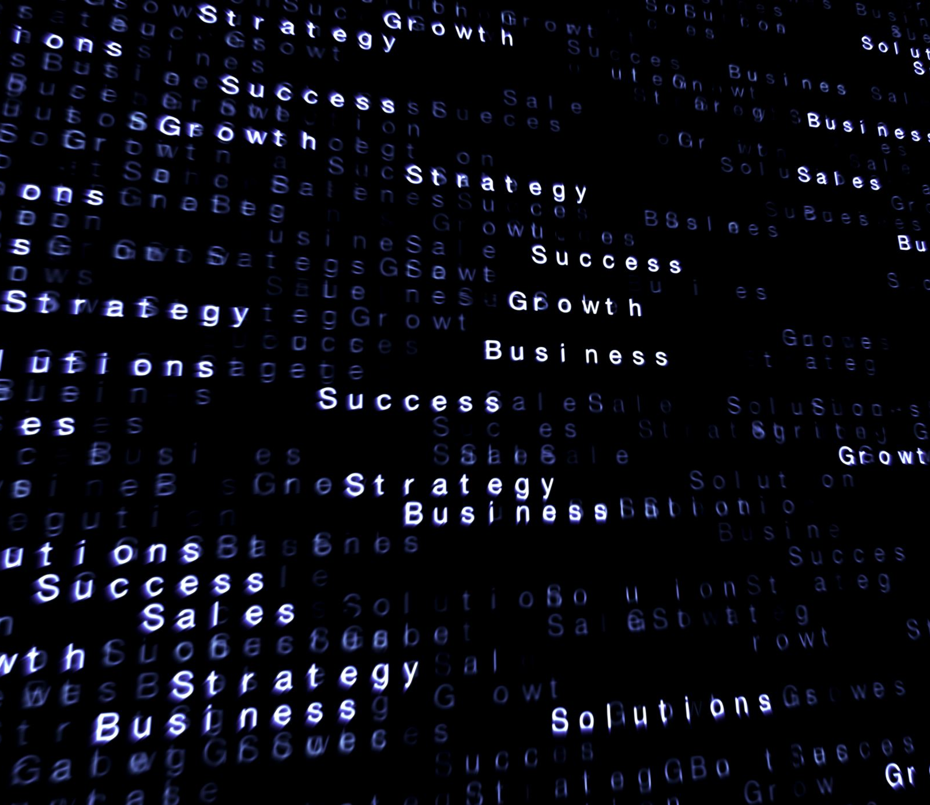
Risk Analysis

Slide 14
Qualitative Analysis
Risk | Potential Hazards | Barriers
Customer/Driver error | Drivers could get in accidents; customers could get in the wrong cars | Description of vehicle, name of customer and driver, driver safety training
Social Engineering | Phishing, corporate espionage, employee intrusion | Longer login passwords, 2fa, increased physical security
User Data | Data not properly encrypted, security systems out of date, espionage | Stronger encryption, employee monitoring of attacks, multiple firewalls

Slide 15
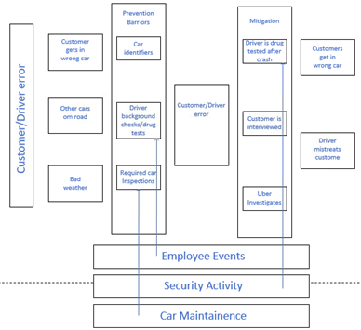
Bowtie Diagram – Customer/Driver Error

Slide 16
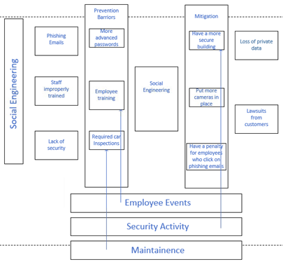
Bowtie Diagram – Social Engineering

Slide 17
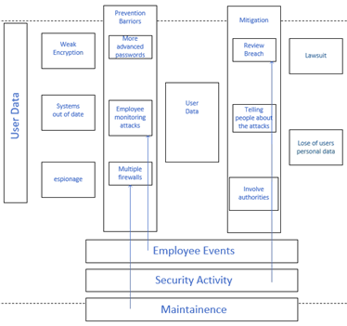
Bowtie Diagram – User Data

Slide 18
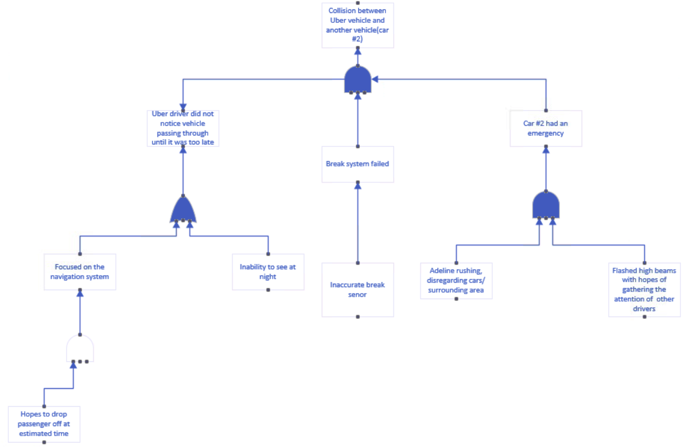
Fault Tree

Slide 19
Risk Influencing Factors
Risk | Barriers | Rating
Customer/Driver error | Description of vehicle, Name of customer and driver, car accidents | 4 - Doesn’t happen often but it can be resolved
Social Engineering | Longer login passwords, 2fa, increased security | 8 - If occurs, sensitive information is lost
User Data | Stronger encryption, employee monitoring of attacks, multiple firewalls | 10 - Account is compromised, user should monitor personal accounts for possible malicious attacks
Notes:
RIF
For customer driver error, customers could get into the wrong car or the driver can get into an accident. We pace this at a 4 because this doesn’t happen often but when it does its quickie resolve.
Social engineering- This could occur when users have weak passwords or become a victim of a phishing attack. Ways to prevent that is to have longer passwords and 2FA. We rated this at an 8 because if this happens your personal information is stolen/lost.
USER DATA- Some risk for this would be data not properly encrypted and possibly security systems being out of data. Uber can add stronger encryptions, monitor employees, and add multiple firewalls. We rated this at a 10 because the account would be compromised and the user should monitor their personal accounts for possible malicious attack

Slide 20
Barrier Analysis
Car Accident |  | Factors
 |  | Human | Equipment | Environment
Phases | Pre-Collision | Car is driving fine, and everyone is okay | All equipment is functioning properly | Driver is focused and aware of surroundings
 | Collision | Someone is injured/hurt | Car is damaged and will need mechanical work done | Inclement weather
 | Post-Collision | Death occurred | Car is totaled | Damages caused by inclement weather

Slide 21
Accident Scenarios
Drive gets distracted while on the job
Driver crashes into another vehicle
Customer is injured and is taken to hospital
Insurance and Uber covers the cost for customer
Uber gets sued

Slide 22
IRPA/PLL
0.0000428% of death caused by Uber (107/2.5 Million)
A = 50 / 200 = 25% (50 hours per week / 200 hours per month)
IRPA (Death due to Uber accidents) = 0.0000428 * .25 = 0.0000107
PLL: 2,500,000 million * IPRA
2,500,000 * 0.0000107 = 26.75 fatalities
With the IPRA/PLL calculation shown above, there are around 26.75 fatalities per year.

Slide 23
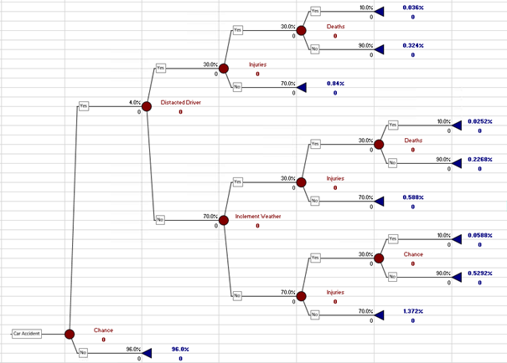
Event Tree Analysis

Slide 24
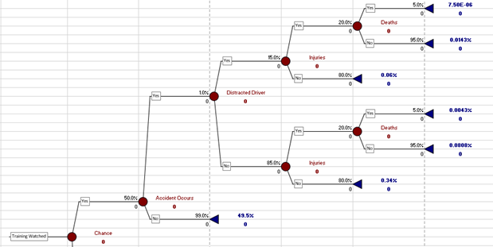
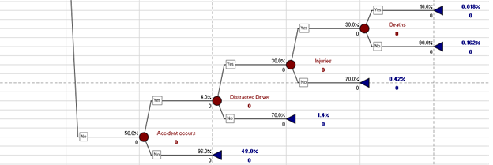
Event Tree Analysis

